Slide 1
Amsterdam
Claude Community
Meetup #5
Thursday 2026-10-29

Slide 2
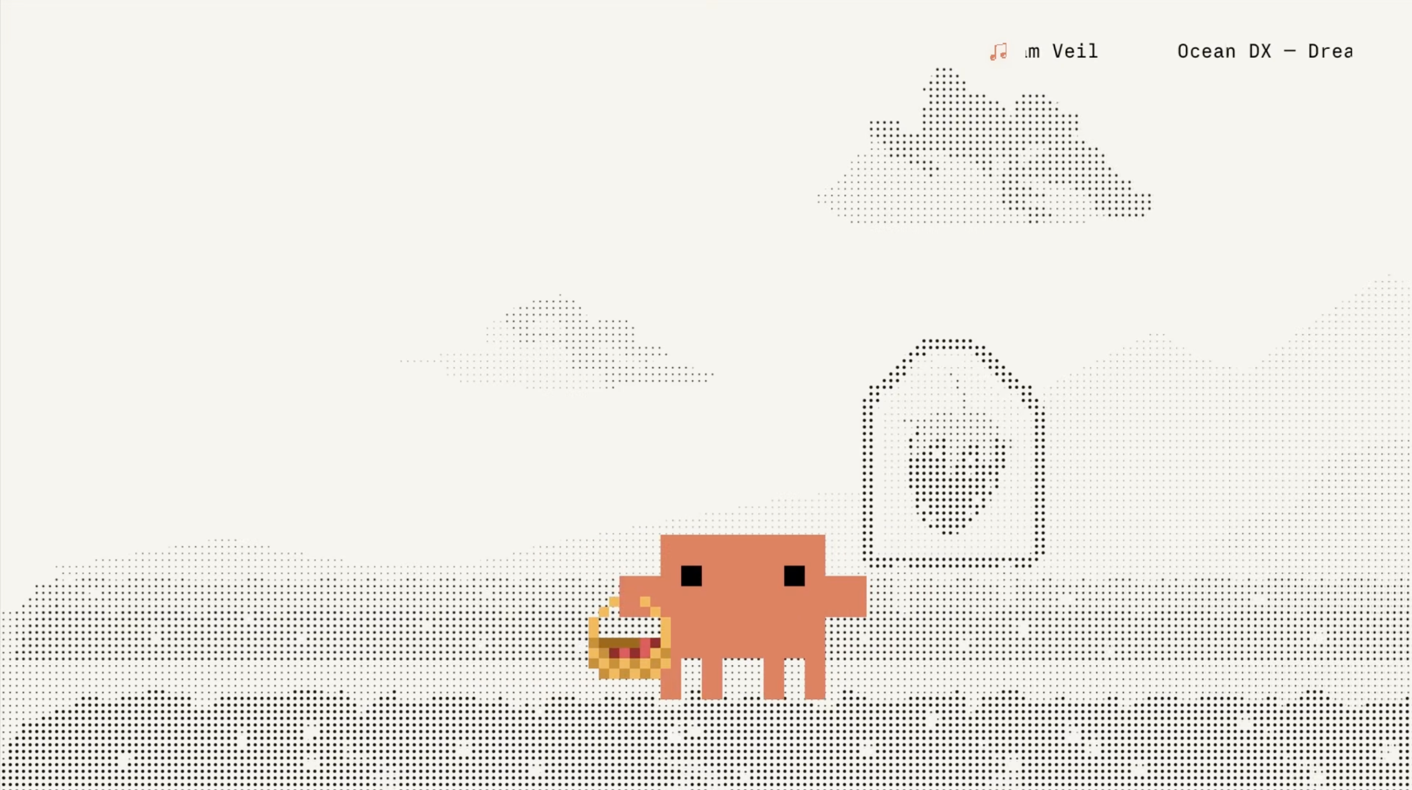
Notes:
[Holding slide] Claude FM: https://www.youtube.com/watch?v=tRsQsTMvPNg

Slide 3



Notes:
[Holding slide] Spinning Globe

Slide 4
Hello, Amsterdam
Check-in and welcome
Notes:
[Welcome slide]

Slide 5
Agenda
Welcome & Intro
Speaker agenda
  Lotte Nederhorst - ML6
  Nicolas Griffioen
Break
  Yehor Dolynskyi
  Ricardo López & José Lomelí
Q&A
Wrap up
Off for drinks @ Het Tuinfeest
Notes:
[Agenda slide]

Slide 6
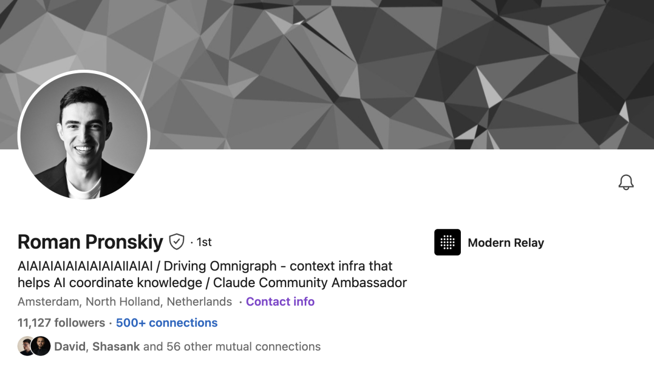
Roman Pronskiy
Claude Community Ambassador

Slide 7
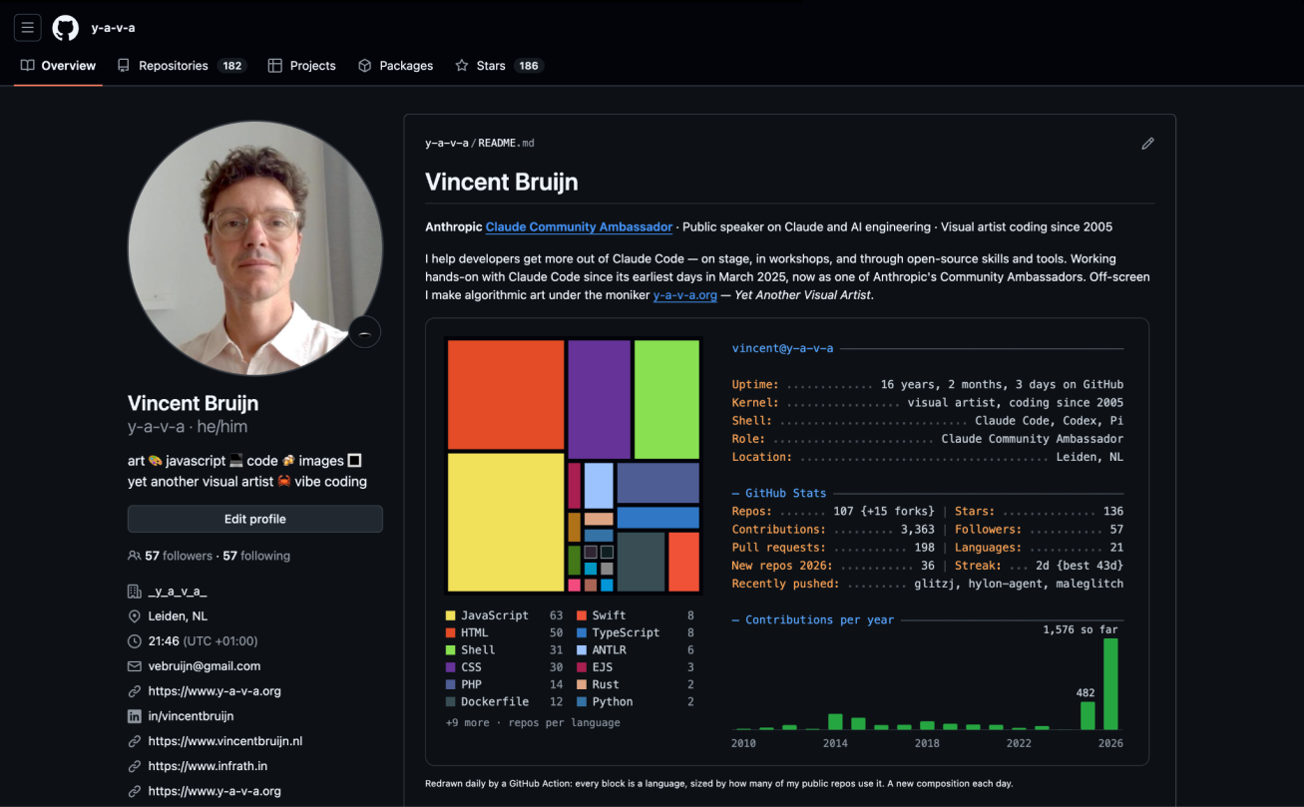
Vincent Bruijn
Claude Community Ambassador
Tech manager at G-STAR
Digital Artist

Slide 8
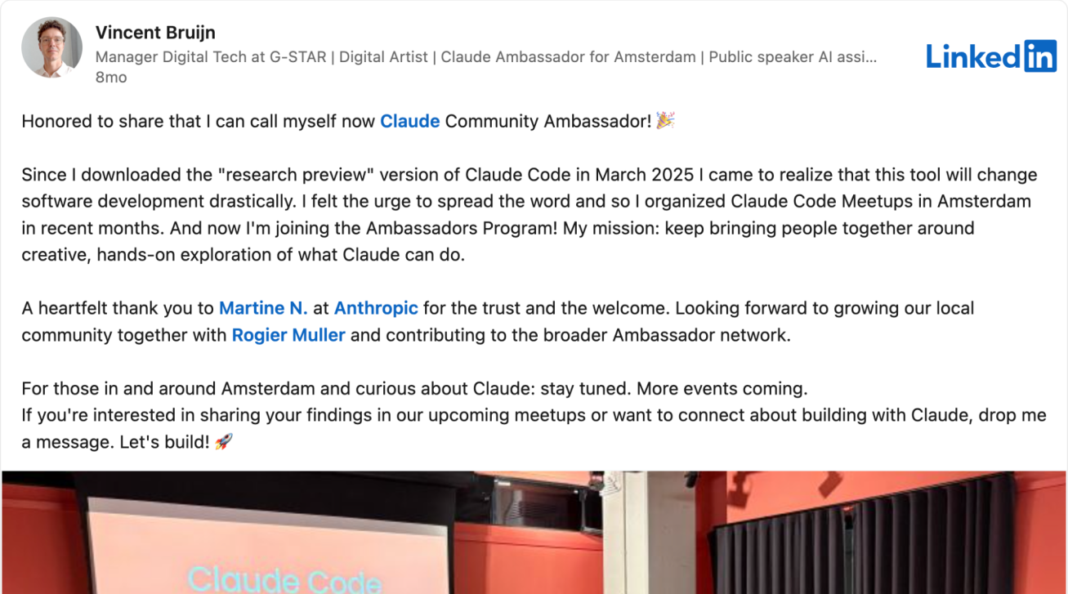
Community Ambassador
“My mission: keep bringing people together around creative, hands-on exploration of what Claude can do.”

Slide 9
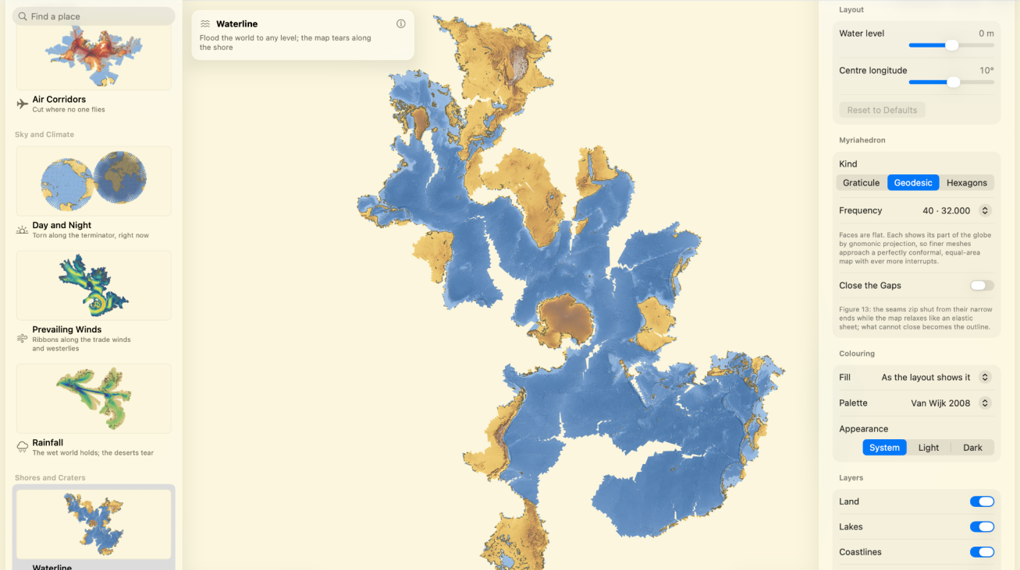
Mac OS app
Myriahedral map projection

Slide 10
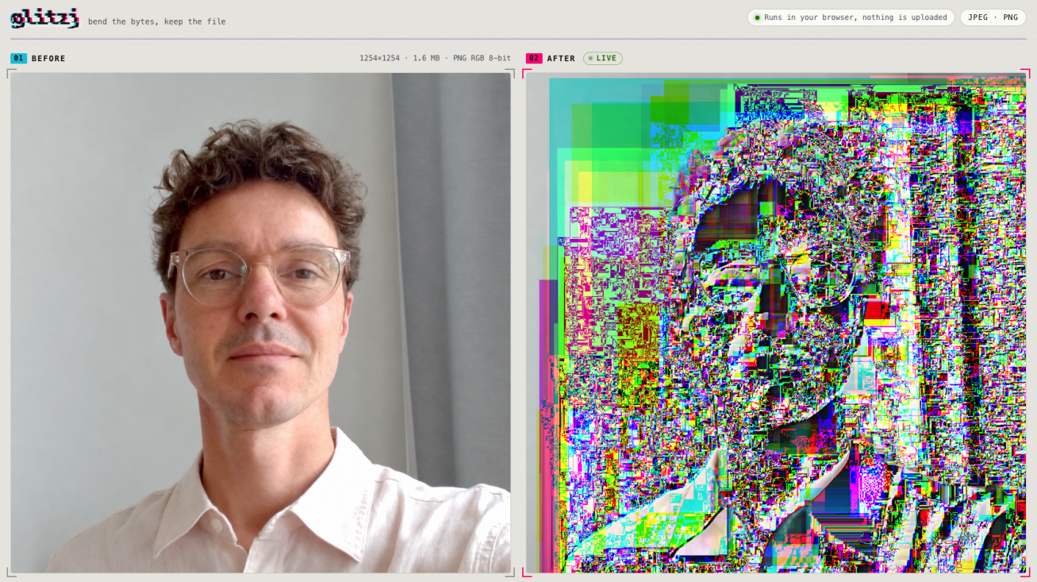
Web app
JPEG, PNG and GIF glitch creation tool.

Slide 11
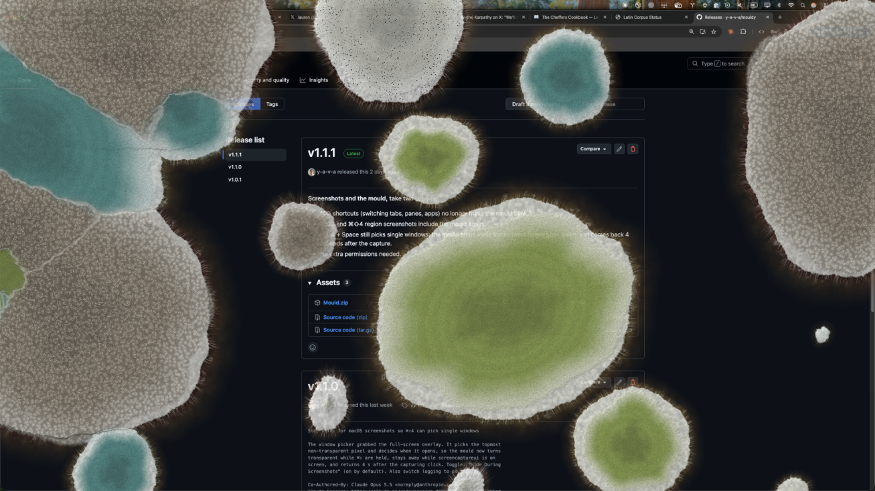
Mould
Mould takes over your screen in the course of an hour.

Slide 12
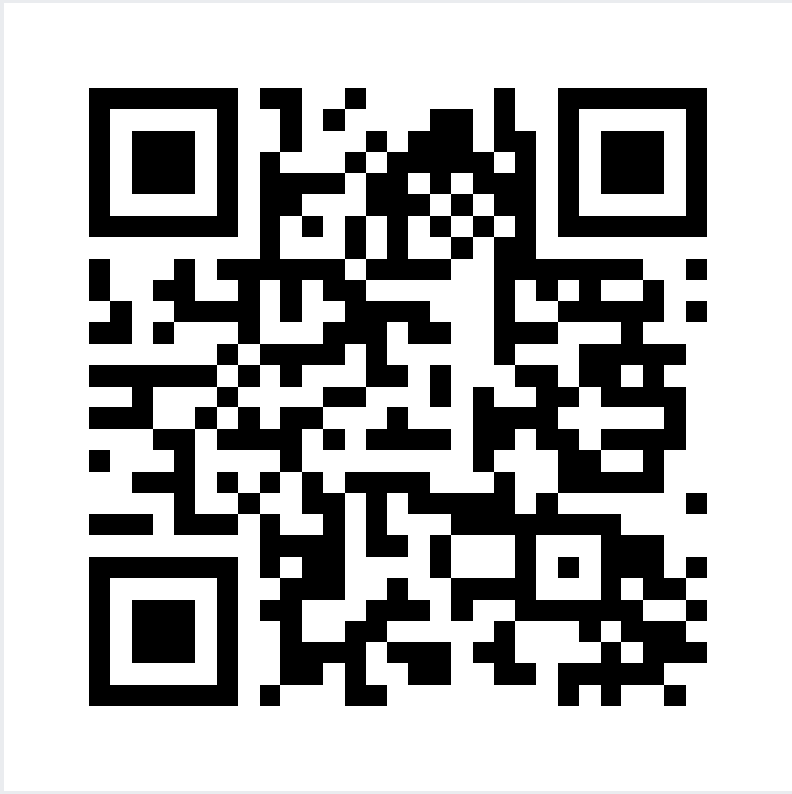
Claude Community Year in Review
Thursday December 10th 2026
My next meetup in Amsteram
Notes:
[Prompt slide]

Slide 13
Talks

Slide 14
Q&A
Notes:
[Q&A slide]

Slide 15

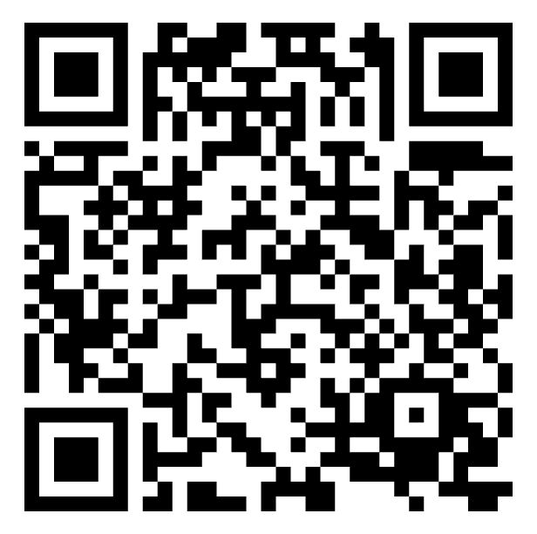

Wrap up
Group photo
Join for a photo, take your own and share it online.
LinkedIn
Scan this for my LinkedIn profile page
Next event
Claude Community
Year in Review
Thu December 10th, 2026

Slide 16
Claude Community Year in Review
Thursday December 10th 2026
My next meetup in Amsteram
Notes:
[Prompt slide]

Slide 17
Thank you, Amsterdam
Wrap up
Notes:
[Closing slide]

